Slide 1




Peptides 101
Better Skin, Strength & Longevity
Dr Dean St. Mart PhD

Slide 2

Introduction
Dr Dean St. Mart PhD
Formulator for Supplement Needs
www.supplementneeds.co.uk
Pharmacologist Advisor for Biolabshop
www.biolabshop.co.uk
Background in Drug Design and Pharmacology
1st Class Honours Degree in Chemistry and Pharmaceutical Chemistry
PhD in Synthetic Organic Chemistry.

Slide 3
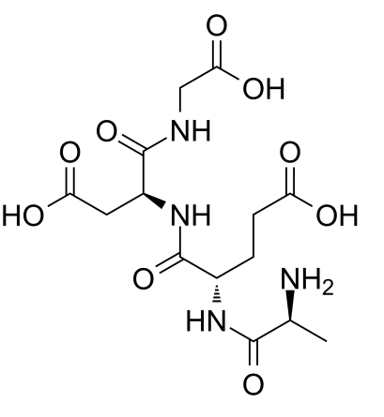
What are Peptides?
Organic chemicals formed by linking two or more amino acid molecules with a peptide bond.
In our body, peptides are formed during protein biosynthesis in a process called translation
and can also be obtained through chemical synthesis.
Our bodies contain over 7,000 naturally occurring peptides that act as neurotransmitters,
and influence hormones, weight, growth factors and overall health.

Slide 4
What are Peptides used for?
Correct human Growth Hormone levels / Anti-aging
Autoimmune disorders
Normal intra-cellular homeostasis / Cytoprotection
Tissue repair including joints, tendons and ligaments, and bones
Obesity / Fat loss
Hormonal balance
Improvement of sexual dysfunction and erectile dysfunction
Oxidative stress
Skin repair and protection
Alzheimer's disease
Insomnia and stress disorders
Depression

Slide 5
Quality Matters
Is the product properly freeze dried?
Is there an internal vacuum?
Powdered vial should “suck” water into vial without having to press on plunger
SubQ injection should be “painless”

Slide 6
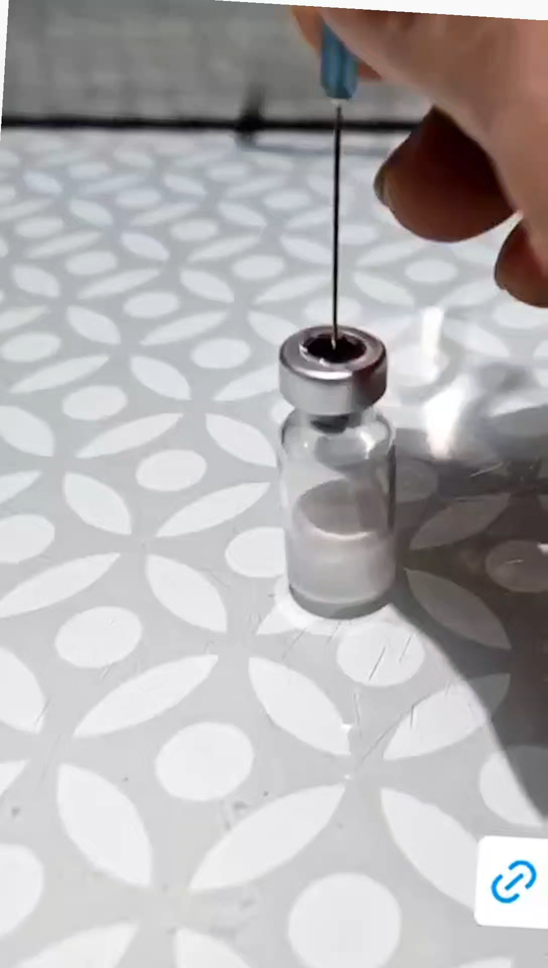
Quality Matters
No internal vacuum ?
Sterility issues
Degradation
Waste of money……

Slide 7
Potential Side Effects
Physical Discomfort including skin reactions at the injection site, such as redness, itching, and swelling
Hormonal Imbalances with potential side effects including mood swings, fatigue, and reduced sexual function
Additionally, long-term misuse may lead to pituitary damage if not utilised correctly
Fluid Retention
Increased Diabetes Susceptibility
Potential for Insulin Resistance
Increased Hunger; certain peptides can stimulate the release of ghrelin, a hormone that induces hunger.
Discomfort from Nausea
Frequent Headaches
Joint Discomfort
However, it's essential to underline that these effects can vary greatly from one individual to another,
largely dictated by the type and dose of peptides used.
Always involve a healthcare professional and adhere strictly to their guidance regarding dosage,
thereby mitigating potential risks to the greatest extent.

Slide 8
Cosmetics and Skin Health
Peptides are an extremely effective anti-aging ingredient used in cosmetics with a very versatile effect.
Peptides owe their effectiveness to a very small size,
They are able to overcome the epidermal barrier and reach their target destination.
They show high biological activity, which means that their effects are visible on the skin in a short time.
According to studies, cosmetics with peptides are among the least potentially allergenic cosmetics,
This is due to the fact that peptides mimic substances naturally found in the human body.

Slide 9
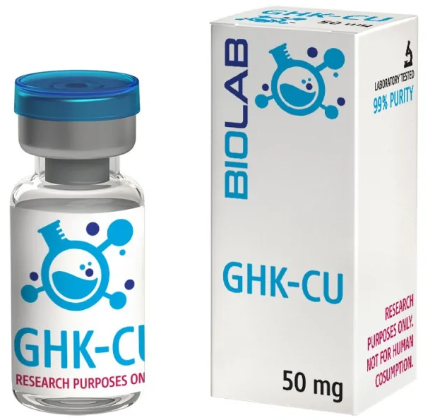
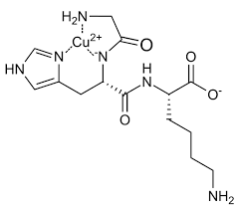
GHK-CU
GHK-Cu is a natural peptide in human blood plasma, urine and saliva.
Animal studies show that GHK-Cu can improve wound healing, immune function and skin health
by stimulating collagen, fibroblasts and promoting blood vessel growth.
Evidence has shown that it acts as a feedback signal that is generated after tissue damage.
It also inhibits free radical damage, making it a powerful antioxidant.

Slide 10
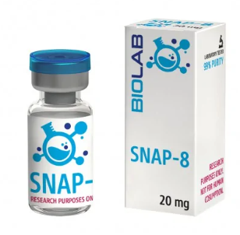
SNAP-8
SNAP-8 is a unique neuropeptide
Tested in terms of reducing wrinkles - reduces skin folds by up to 60%.
Acetyl-octapetide-1 is a synthetic peptide that is an extended chain of amino acids known as Argineline
i.e. a neuropeptide that inhibits muscle contractions.
Mechanism of action is based on the local reduction of acetylcholine, an excitatory neurotransmitter
Local reduction of the contractile capacity of muscles, thus relaxing them and, smoothing out expression lines.

Slide 11
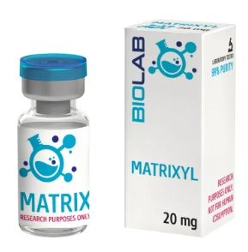
Matrixyl
Palmitoyl pentapeptide-4, is a safer and more effective anti-aging ingredient than retinol.
Prevents the formation of wrinkles, moisturizes the skin, preventing it from drying out,
Mimics the action of "matrykins" - naturally occurring peptides that are associated with our collagen fibers.
As we age, our collagen fibers gradually break down, allowing matricins to be released from their binding site.
Free matricins can bind to fiber-producing cells (called fibroblasts) to trigger and stimulate the production
of new, young and healthy fibers, mainly collagen and elastin, which give the skin firmness and elasticity.
Matrykins also stimulate the production of hyaluronic acid - a key molecule that keeps the skin
well hydrated and plump.
Aging skin releases less matricins over time, meaning our skin breaks down from the inside out without
adequate fiber replenishment.
One study involving 28 women showed that after just 2 months of using Matrixyl,
the volume of deep wrinkles was reduced by 45%, and skin tension increased by almost 20%.

Slide 12

Optimising Sports Recovery and Performance
Peptides can help with sports recovery by stimulating physiological processes that
reduce inflammation, enhance tissue repair, and boost growth hormone production.
This can help athletes and fitness enthusiasts recover faster and gain muscle.
Main considerations:
  BPC-157
  TB-500
  Human Growth Hormone (hGH)
  IGF-1 LR3
  MGF / PEG-MGF
© SN Education

Slide 13
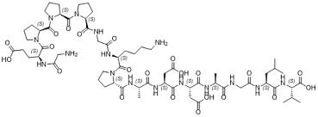
BPC-157
BPC-157 is a peptide known for its healing and recovery properties.
Body Protection Compound is a stable pentadecapeptide first derived from gastric juices.
Research has shown that BPC-157 enhances the growth hormone receptor expression in tendon fibroblasts,
promoting healing and recovery.
Helps heal tissues by modulating angiogenesis (blood vessel creation).
Neuroprotective, improves nerve regeneration.
Decreases neuroinflammation.

Slide 14
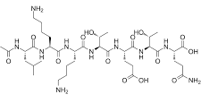
Thymosin Beta 4 / TB500
TB-500 is a synthetic replica of a protein called Thymosin Beta 4.
According to the research, TB-500 could allow animals to regenerate muscles, joints, ligaments, bones
and tendons and speed up wound healing time.
It works by regulation of the process of building and transport of cells.
TB4 can down regulate inflammatory cytokines and chemokines.
TB4 can promote blood vessel formation and cell survival.
TB4 has been shown to preserve cardiac function and improve ejection fraction.
Often taken in combination with BPC-157 and hGH.

Slide 15
Human Growth Hormone
Growth hormone (GH) is a polypeptide hormone secreted by the pituitary gland in a pulsatile manner
every two hours with a mean daily secretion of 0.5 mg or 1.5 IU.
When administered by mouth GH is completely digested to its constituent amino acids.
Growth hormone secretion is controlled by two hypothalamic peptides:
growth hormone releasing hormone (GHRH) and somatostatin (SS).
The most important stimuli of GH secretion in humans are sleep, exercise and stress.
Supraphysiological dosages of hGH can increase reactive oxygen species (oxidative stress).

Slide 16
Insulin-like Growth Factor-1 Long R3
IGF-1 is polypeptide long-chain amino acid peptide hormone, released primarily in the liver
with the stimulus of growth hormone (HGH).
Growth peptides cause a direct effect on muscles in the body by actual development of cells.
Benefits of Insulin-like Growth Factor 1 include:
  Protein synthesis in the body
  Fat storage is channeled for energy production, which results in a noticeable fat loss.
  Positive effects on metabolism, increasing lean body mass and decreasing fat
  Increase in regenerative properties of the body’s nerve tissues
  Upregulates antioxidant benefit and ligament strength
  Boosts hyperplasia in muscle cells, which leads to fuller muscle tissues.
  Improved cognitive function

Slide 17
MGF / PEG-MGF
Mechanical Growth Factor (MGF, insulin-like growth factor-1Ec, IGF-1Ec) is a protein isoform of the IGF-1
family of insulin-like growth factors.
Regulation of growth, development and differentiation of cells and tissues.
After exercise, the IGF-1 gene is spliced towards MGF to begin hypertrophy.
According to ongoing research, MGF could activate and replenish the muscle stem cell pool.
Stimulates satellite cells to proliferate, aids wound healing, and potentially cardiac tissue repair.
PEG works as a protective coating, improving the stability and half-life from 5 mins to 48 hrs.

Slide 18
What’s the most important cell in your body?

Slide 19
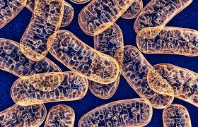
Health and Longevity

Slide 20
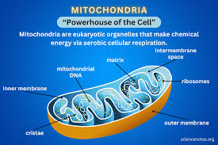
Health and Longevity

Slide 21
Disease is driven by Oxidative Stress
Anti-oxidants are the answer

Slide 22
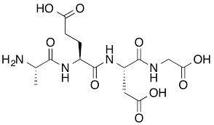
Health and Longevity
Epithalon (also known as Epitalon or Epithalone) is the synthetic version of the polypeptide Epithalamin,
which is naturally produced in the pineal gland.
It was discovered by the Russian scientist Professor Vladimir Khavinson,
who then conducted epitalon-related research for the next 35 years in both animal and human clinical trials.
Epitalon’s primary role is to increase the natural production of telomerase,
a natural enzyme that helps cells reproduce telomeres, which are the protective parts of our DNA.
This allows the replication of our DNA so the body can grow new cells and rejuvenate old ones

Slide 23
Health and Longevity
Epitalon also plays a role in regulating metabolism, increasing the sensitivity of hypothalamus
to its natural hormonal influences, normalizing the function of the anterior pituitary
and regulating the levels of gonadotropins and melatonin in the body.
Mechanisms of action:
  Increases lifespan by lengthening telomeres in human cells
  Promotes deeper sleep
  Delays and prevents of age-related diseases such as cancer, heart disease, and dementia
  Acts as an antioxidant by reducing lipid oxidation and ROS (Reactive oxygen species)
  Normalizes T cell function
  Improves skin health and appearance
  Heals injured and deteriorating muscle cells
  Restores and normalizes melatonin levels in those who have lost some pineal function due to aging
  Can increase resistance to emotional stress

Slide 24
Fat Loss
2 main peptide types:
  Growth Hormone Releasing Hormone (GHRH)
  Growth Hormone Releasing Peptide (GHRP)
Both upregulate endogenous GH and IGF to improve cell efficiency in many clinically proven ways.
Functions of Growth Hormone:
  Upregulating beta oxidation (breaking down fatty acids to produce acetyl-CoA for energy.
  Upregulating oxidative phosphorylation (a metabolic process that produces adenosine triphosphate (ATP) in cells)
  Upregulating PGC-1alpha (a protein that regulates energy homeostasis and mitochondrial function)
  Upregulating PPAR-gamma (an enzyme that regulates lipid and glucose metabolism, anti-inflammatory).
  Improving mitochondrial efficiency
  Upregulating the SIRT longevity gene

Slide 25
Fat Loss
Growth Hormone Releasing Hormones (GHRH)
  Mod GRF(1-29) / CJC-1295 (No DAC)
  CJC-1295-DAC
  Sermorelin
Growth Hormone Releasing Peptides (GHRPs)
  GHRP-2
  GHRP-6
  Ipamorelin

Slide 26
Fat Loss
These are the only peptides now known to be affected by nutrition due to relying on Ghrelin feedback.
A general scheme of use could be utilizing them before bedtime to ensure stage 4 sleep improvement
and first thing in the morning before eating breakfast.
30-45 min period of no food after dosing.
60-90 min of no food before administration.

Slide 27
Thank you
www.supplementneeds.co.uk – DRDEAN for 10% off
www.biolabshop.co.uk – DRDEAN for 7% off
www.sneducation.co.uk

