Slide 1
Estrogen
Gone
Wild
Carrie Jones, ND, FABNE, MPH
Notes:
Love this – Keep this as the style of the title slide moving forward

Slide 2
egg
Follicular Phase
Ovulation
Luteal Phase
Normal Menstrual Cycle
Ovulation
Progesterone
Estrogen
LH (luteinizing hormone)
FSH (follicle-stimulating hormone)
Start of the cycle
Day 7
Day 14
Day 21
Day 28

Slide 3


Note:
You have a master rhythm in your body called the Circadian Rhythm.
This impacts your Menstrual Cycle rhythm.
All rhythms in the body are connected.
Copyright 2022: Carrie Jones, ND, FABNE, MPH

Slide 4
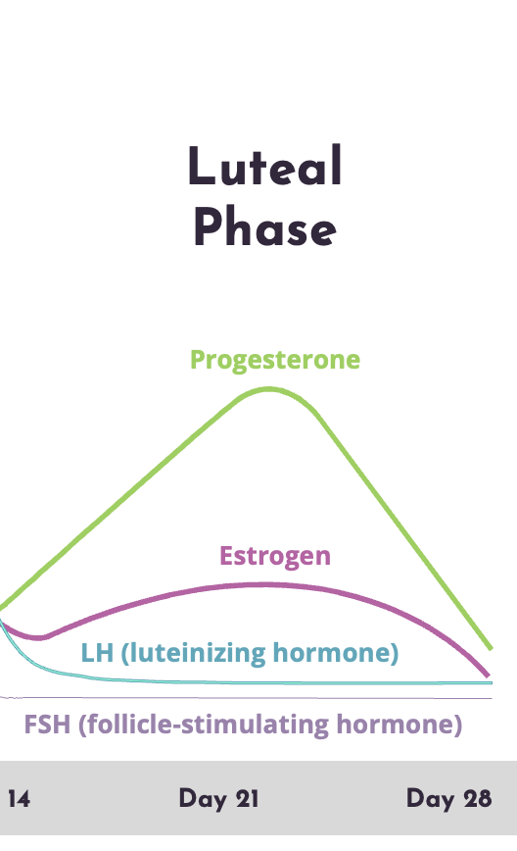


Slide 6
How much estrogen and progesterone are made?
Estradiol:
Progesterone:
Progesterone:
Post-Menopause
Mid-luteal = about
250 mcg/day
Mid-luteal = about
25-40mg/day
<1mg/day
Notes:
Let’s cut this into 2 slides about ‘Remember’ – slide 1: Remember: Whether she wants to or not, the female body centers everything around the potential to become pregnant/procreation
Slide 2 will be Remember: with all the info boxes on this slide

Slide 7
Excessive Estrogen or
Estrogen Dominance?
Copyright 2022: Carrie Jones, ND, FABNE, MPH

Slide 8
What does it mean?
In the luteal phase…
Term is shortened to “estrogen dominance” or “excessive estrogen”
If the estradiol levels are out of balance compared to the progesterone.
Estradiol is elevated and/or progesterone
is low

Slide 9
Cravings
Hormonal acne
Migraines*
Bloating
Insomnia
Etc.
PMS
Fibroid or polyp growth
Heavy periods/clots
Cramps
Fuller, tender breasts
Mood swings
Worse endometriosis
Copyright 2022: Carrie Jones, ND, FABNE, MPH

Slide 10
How does this imbalance occur?
Estrogen Reasons:
Overproduction of your own estrogen
Slow estrogen metabolism/detoxification out
Endocrine disrupting chemicals mimicking estrogen

Slide 11

How does this imbalance occur?
Progesterone Reasons:
Anovulation (no egg) = no progesterone
Ovulation with decreased progesterone production
Ovulation with short luteal phase

Slide 12

Finding the Cause
Copyright 2022: Carrie Jones, ND, FABNE, MPH

Slide 13
Age (Peri-meno/menopause)
Hysterectomy with ovaries removed
Anorexia/disordered eating
Low cholesterol (backbone to hormones)
Inflammation in the ovaries Extreme exercise or training
Extreme stress
Under appropriate body weight percentage for height/age
Brain injury
Hypogonadism (ovaries fail)
Hypopituitarism (pituitary not communicating)
Endocrine disrupting chemicals
Slow estrogen detoxification
Breast feeding
High prolactin (in general)
Hypothyroidism
PCOS
Diabetes (not well controlled)
Infections: overt or stealth
Major sleep disturbance/crossing time zones
Decreased blood flow to the ovaries (Surgery, smoking, diabetics, scars, etc)
Opioid pain medications (last 6 mo.)
NSAIDS -diclofenac, naproxen after just 10 days can suppress ovulation
Mirena (or similar) IUD/coil can partially or fully suppress ovulation
Hormonal birth control
Why causes the imbalance?
Copyright 2022: Carrie Jones, ND, FABNE, MPH

Slide 14
Side note on Prolactin
Copyright 2022: Carrie Jones, ND, FABNE, MPH

Slide 15

Prolactin = Pro-Lactation?
Anovulation (no egg)
Skipped cycles
Even mildly high prolactin can cause:
Irregular cycles
Decreased fertility
Hypogonadotropic hypogonadism
Decreased libido
Nipples leak milk
Copyright 2022: Carrie Jones, ND, FABNE, MPH

Slide 16
Common Causes of High Prolactin
Normal range: 5-25 ng/ml
Causes: Mild to Moderately High (generally)
Low dopamine (brain hormone)
Dopamine antagonist medications
Low GABA (brain hormones)
High histamine (↓dopamine)
H2 receptor antagonist medications
  (ie. Cimetidine)
SSRI’s depression medications
Hypothyroidism
Low vitamin B6
High cortisol
Causes: Very High
Breast feeding
Prolactinoma
Other pituitary tumors
Copyright 2022: Carrie Jones, ND, FABNE, MPH

Slide 17
Endocrine Disrupting Chemicals
Copyright 2022: Carrie Jones, ND, FABNE, MPH

Slide 18


Endocrine Disrupting Chemicals
“Estrogen Mimickers”
Copyright 2022: Carrie Jones, ND, FABNE, MPH

Slide 19
Estrogen
Detoxification
Copyright 2022: Carrie Jones, ND, FABNE, MPH

Slide 20
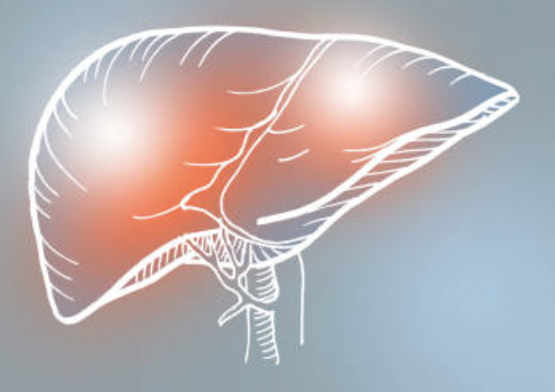
Copyright 2022: Carrie Jones, ND, FABNE, MPH

Slide 21
Phase I
The first transition
Phase II
Neutralize and make water soluble
Toxins or Hormones
Phase 3
Intermediary metabolites
Reactions
Support Options
Reactions
Support Options
Oxidation
Reduction
Hydrolysis
Hydration
Dehalogenation
Riboflavin (Vit B2)
Niacin (Vit B3)
P5P(Vit B6)
Folate
Vitamin B12
Glutathione
BCAA
Resveratrol
Flavinoids
DIM/I3C
Sulfation
Glucuronidation
Glutathione conjugation
Acetylation
Amino acid conjugation
Methylation
PAPs
Magnesium
Glycine/Taurine
Glutamine
Glutathione
N-Acetylcysteine
Cysteine
Selenium
Methylated B’s
Zinc
TMG
Choline
Methionine
Sulforaphane
Bile
Serum
Reactive oxygen intermediates
stool
Kidneys
Free Radicals
Urine
Antioxidant protective nutrients and plant derivatives
Carotenes (Vit A)
Ascorbic acid (Vit C)
Tocopherols (Vit E)
Selenium
Copper
Zinc
Manganese
PQQ/Coenzyme Q10
Thiols ( garlic, onions, cruciferous vegetables)
Bioflavinoids
Milk thistle
Pycnogenol
Glutathione
Sulforaphane
End products of metabolism
Bacterial endotoxins
Exotoxins
Drugs (prescription, OTC, recreational)
Agricultural chemicals
Food additives
Household chemicals Pollutants/contaminants
Microbail
Copyright 2022: Carrie Jones, ND, FABNE, MPH

Slide 22
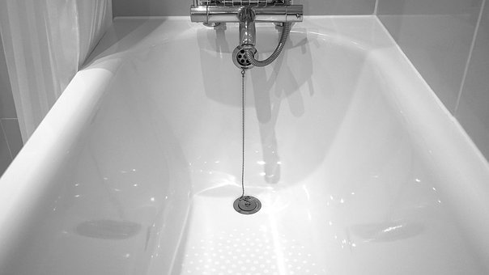
Sewer line out
Copyright 2022: Carrie Jones, ND, FABNE, MPH
Sewer

Slide 23
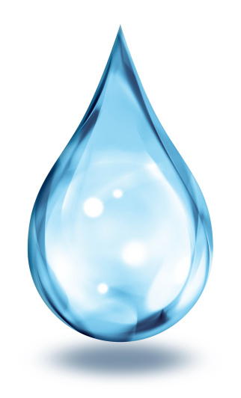
Phase 1 Estrogen Detox.
“First transition”
2OH (CYP1A1) 16OH (CYP3A4)
4OH (CYP1B1)
Sewer line out
Copyright 2022: Carrie Jones, ND, FABNE, MPH
Sewer

Slide 24
Phase 1 Estrogen Detox.
2OH (CYP1A1) 16OH (CYP3A4)
4OH (CYP1B1)
Methylation COMT + Mg
Glucuronidation or Sulfation
Phase 2 Estrogen Detox.
“neutralize & water soluble”
Sewer line out
Copyright 2022: Carrie Jones, ND, FABNE, MPH
Sewer

Slide 25


Phase 1 Estrogen Detox.
2OH (CYP1A1) 16OH (CYP3A4)
4OH (CYP1B1)
Methylation COMT + Mg
Glucuronidation or Sulfation
Phase 2 Estrogen Detox.
Phase 3 Estrogen Detox.
“Get it out”
Sewer line out
Copyright 2022: Carrie Jones, ND, FABNE, MPH
Sewer

Slide 26
What can I do?
Copyright 2022: Carrie Jones, ND, FABNE, MPH

Slide 27
Improve Estrogen/Progesterone
Listen to everything in B Better!
Understand your cycle (if you’re having one)
Test your hormones including thyroid and prolactin.
Work on your rhythms! Sleep, waking, movement, eating, etc.
Truly evaluate the stress in your life.
Work to minimize endocrine disrupting chemicals in your life

Slide 28
Improve Estrogen/Progesterone
Minimize or eliminate alcohol
Regular movement/sweat helps
Poop daily or else get your intestinal health evaluated
Are you absorbing the foods you eat or supplements you take?
Do you need more work up? Mold/mycotoxins, histamine, etc?
Are you eating enough protein? Are you dehydrated?
Consider the basics: B-vitamins, magnesium + other minerals

Slide 29

Thank you for listening!
Copyright 2022: Carrie Jones, ND, FABNE, MPH

